Slide 1

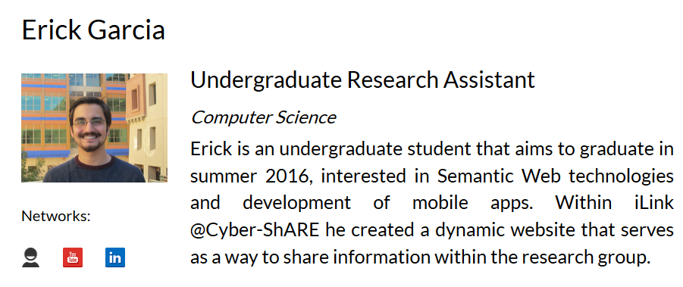


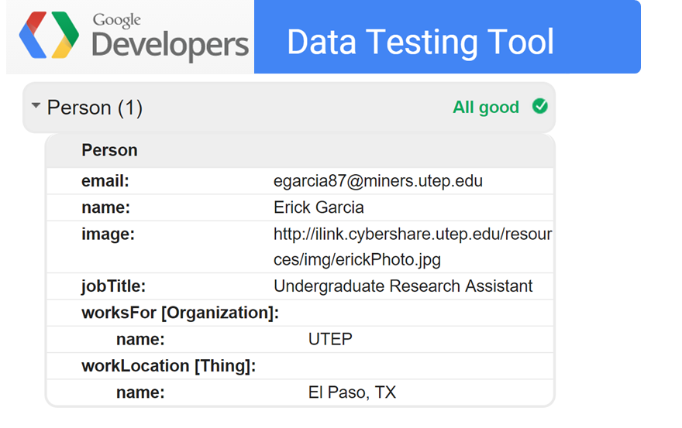

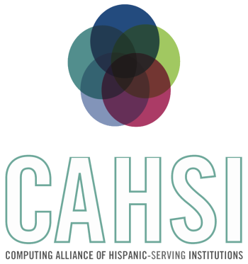


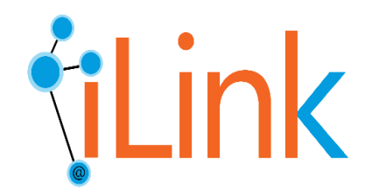
CYBER-ShARE Center of Excellence
Sharing Resources to Advance Research and Education through Cyber-infrastructure
Semantic-based data integration and exchange for a research group
Erick Garcia^{1,2}, Natalia Villanueva-Rosales^{1,2}
Faculty Mentor: Dr. Natalia Villanueva Rosales^{1,2}
¹Department of Computer Science, ²Cyber-ShARE Center of Excellence
egarcia87@miners.utep.edu, nvillanuevarosales@utep.edu
The University of Texas at El Paso
Abstract
Disseminating products resulting from research efforts for validation, reproducibility, and reuse is an important task of a research group. Sharing resources using natural languages, like English, are good for humans but hard for computers to process. Sharing resources using machine languages, like JSON, are great for machines but hard for humans to understand. Having a one-stop place where resources of research groups can be dynamically populated from other sources and share information for both, humans and machines, would save time and also increase reusability of their resources. In this paper, we describe our approach to disseminate the products of the iLink group through a web-based application that is: i) dynamically populated from heterogeneous sources, ii) dynamically annotated using meta-data vocabularies (schema.org) for machine processing, iii) mobile-friendly for human consumption, and iv) interoperable with other systems due to the use of web standards. This work has been evaluated with a data-driven evaluation to ensure that data was not lost in the integration process and by evaluating the discoverability of our resources using the meta-data vocabulary. Our future work includes the creation of an SPARQL endpoint to increase the accessibility of our products, the creation of a sustainability plan to guarantee the availability of the research products and resources and extending the coverage of our approach to include the other two research groups of the Cyber-ShARE Center of Excelence at UTEP, namely iSense and iFuse.
Introduction
Results
The Semantic Web is a set of standard languages and tools promoted by the World Wide Web Consortium for exposing machine understandable data to be shared and reused. [2]
Web-Services are applications that enable the communication between two electronic devices over a network. [2]
Metadata is structured information that describes, explains, locates, or otherwise makes it easier to retrieve, use, or manage an information resource. It facilitates discovery of relevant information. [1]
Maintaining information about research group efforts is a tedious manual task.
Sharing resources using natural languages, like English, are good for humans but hard for computers to process. Sharing resources using machine languages, are great for machines but its not a readable data format (Fig. 1).
Having a one stop place where resources of research groups can be dynamically populated from other sources and share information for both, humans and machines, would save time and also increase reusability of their resources.
The iLink research group’s dynamic website was created. This website is: i) dynamically populated from other sources, ii) based on Model-View-Controller architecture, iii) based on standard web-languages and technologies including Bootstrap, Code Igniter, HTML5 and JSON.
The information shared on the iLink’s website is semantically annotated which means it is fully understandable for both humans and machines. (Fig. 2 & 3)
Person
hasJobTitle
Job Title
hasResearchInterest
hasDegree
hasPersonalWebsite
Degree
<meta>
</meta>
DB
Personal Website
Research Interests
Dynamic
Semantically Anotated
Mobile Friendly
Figure 2. Differences between data that can be understood by humans vs. data that can be understood by machines.
Resources
Figure 1. By Integrating the research group’s resources and the metadata you can get a dynamic, semantic a
Research Question
Can semantic-, web-based approaches, e.g., ontologies, enable the creation of systems that automatically integrate information about a research group and share information for both humans and machines?
Objective
Design a web-based application for the iLink research group that can be :
dynamically populated from heterogeneous sources,
mobile-friendly for human consumption,
use web standards for interoperability of other systems, and
share resources using semantic annotations (meta-data) for machine processing.
Figure 3. Using the testing tool from google to check that the data can be understood by search engines. [5]
Conclusions & Future Work
Methodology
Evaluation of the system based on:
Discoverability of resources by machines using metadata.
Usability for human users.
The ability of search engines understanding the websites data so there will be more accurate results to what the user is searching.
The semantic annotation was done in RDFa instead of Microformats, or Microdata has the advantage of being able to create your own vocabulary if it does not already exist.
Design of a high-level data model (E/R diagram) that covers information retrieved from other sources and metadata
Evaluation for frameworks for web development that supports the creation of responsive mobile-, human-friendly website and the use of standards for interoperability
Development of a front- and back- end of a research group website through the use latest web-based technologies.
Comparison of metadata standards and vocabulary to share research group’s resources with semantic annotations.
Semantic Annotation of all the information shared through the website.
Evaluate the web-based system.
References
[1] Understanding Metadata (pp. 4-10). (2004). Bethesda, NISO Press National Information Standards Organization
[2] Semantic Web, Retrieved April 15, 2015 from http://www.w3.org/standards/semanticweb/data
[3] FOAF, Retrieved April 15, 2015 from http://www.foaf-project.org/.
[4] iLink Website: http://iLink.cybershare.utep.edu/
[5] Structured Data Testing Tool, Google, Retrieved April 15, 2015 from https://developers.google.com/structured-data/testing-tool/
This work used resources from the Cyber-ShARE Center of Excellence and the Computing Alliance of Hispanic Serving Institutions (CAHSI), which are supported by National Science Foundation, grant numbers HRD-0734825 and CNS-1042341 respectively. Special thanks to the iLink research group members for their support in this work.
Linking knowledge across disciplines,
data and models
Cyber-ShARE

